Slide 1
Diet-tracking app
Team BearPaw - Chau Tran, Terrance Miller, Trung Nguyen

Slide 2
Team members
Chau Tran
Major: Computer Science
Email: trhmc1811@gmail.com
Terrance Miller
Major: Computer Science
Email: TerranceMillerh01@gmail.com
Trung Nguyen
Major: Computer Science
Email: trungnguyen212001@gmail.com
Faculty Advisor:
Dr. Boyang Wang
Email: wang2ba@ucmail.uc.edu

Slide 3
Project Background
Set out to create an application that focused on user experience and utilized machine learning for a recommendation service.
Narrowed down to a health app that would provide diet tracking and other possible health services through our application.
Choose to make a web application because that would be the most accessible option for potential users.
Broke up the project into 3 parts
The front-end in React
The login page/database in Django
The meal recommender made with python libraries (scikit-learn, pandas, numpy)

Slide 4
Project Description
Account creation
Personalize goals
Daily Progress Tracking
Track Calories and other important nutrition data.
Account Progress
Accountability Tracking
Meal Logging
Manual logging
Meal Recommender
Provides automatic nutrition logging*

Slide 5
Broader Impacts
Make an application that can apply universally to everyone
Emphasis on letting users create their own experience
Our desire is to give people a tool to help take control of their diet

Slide 6
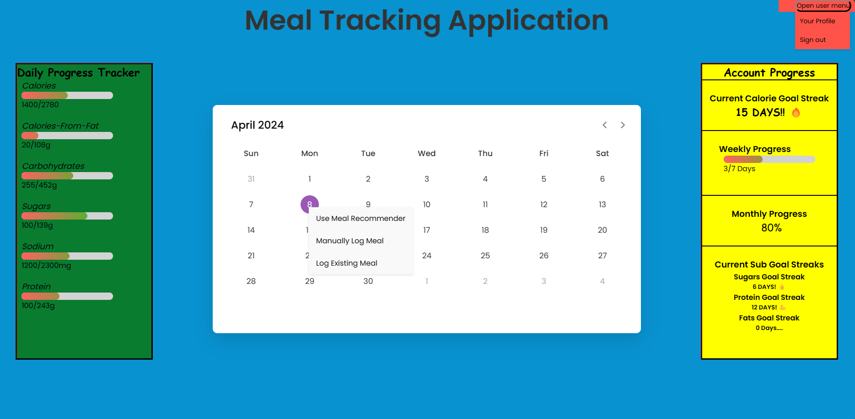
Design (React Frontend)
Homepage:
User can log their nutrition input for each day
Daily nutrition progress tracker
Account progress section for user encouragement/ accountability
Simple user friendly UI

Slide 7
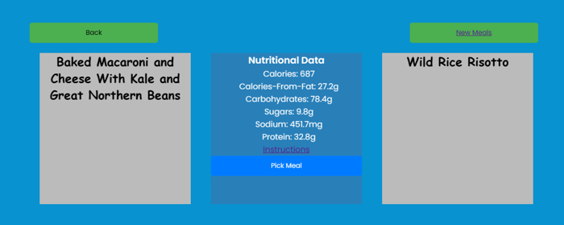
Design (React Frontend)
Meal Recommendation page:
Utilizing user nutrition requirements to generate
Provides recipes with nutrition information
Simple and convenient to track and add meal to nutrition intake

Slide 8
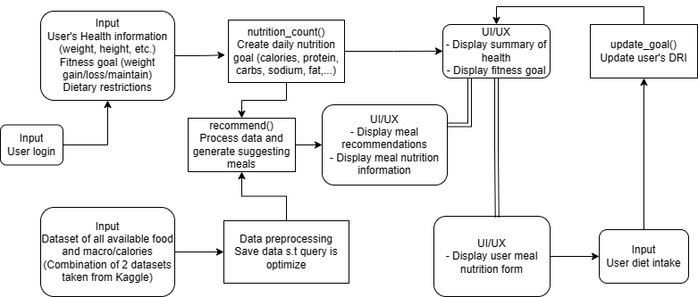
Design (Django Backend)
Authentication:
Login-based authentication via access and refresh keys
Password protected with SHA256 encryption
User model:
Include health information
Include nutrition information
Include recommend method

Slide 9
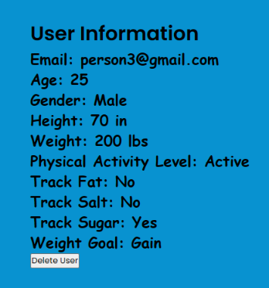
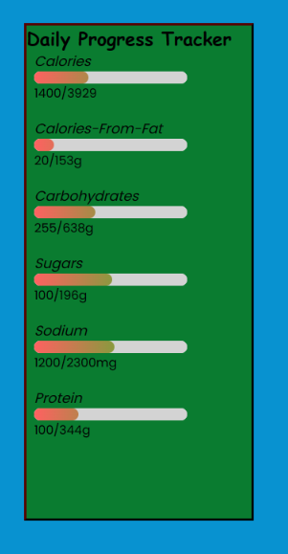
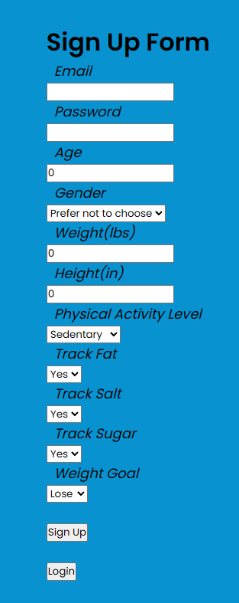
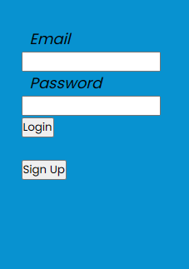
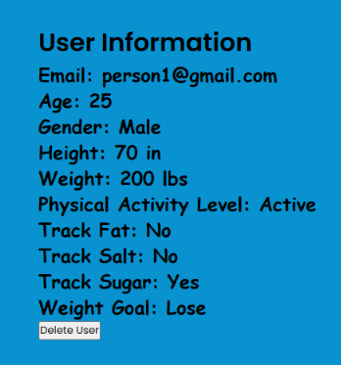
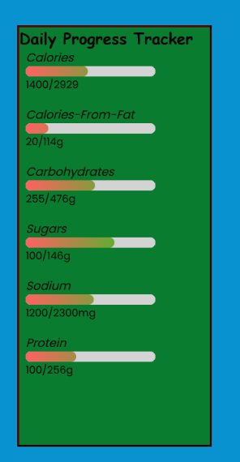
Design (Django Backend)
User daily nutrition example:
User sign up example:
User login example:

Slide 10
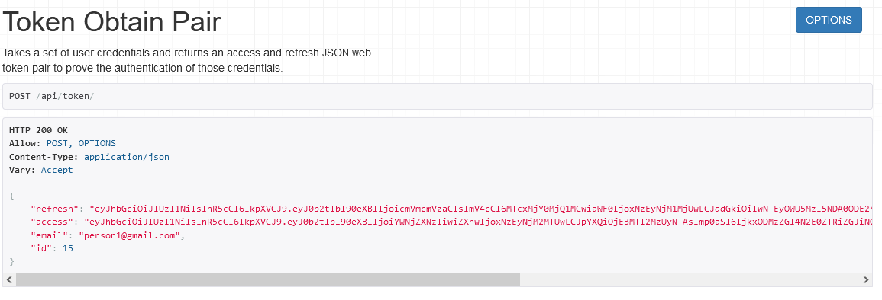
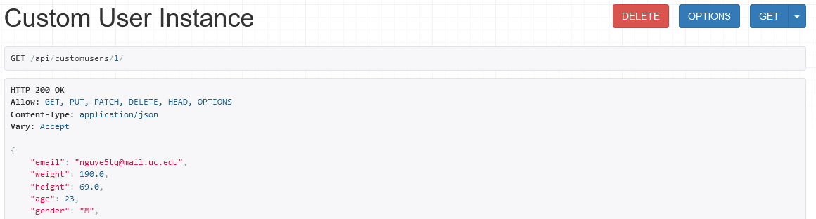
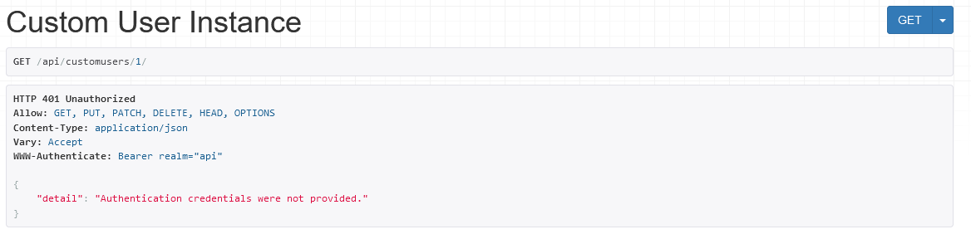
Design (Django Backend)
API call example:

Slide 11

Design (Django Backend)
Nutrition Pipeline:
Calculate user daily nutrition requirements
Calculation taken from Dietary Reference Intake (DRI) and Dietary Guidelines (DGA)
Recommend relevant meal recipes
Food recipes taken from Kaggle Food.com dataset
Find similar recipes to user need by k-nearest-neighbor
Allow randomize recommendations
Update user daily nutrition goal from user input

Slide 12
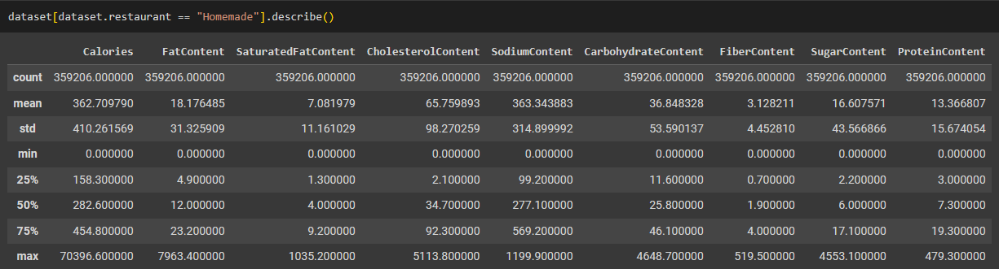
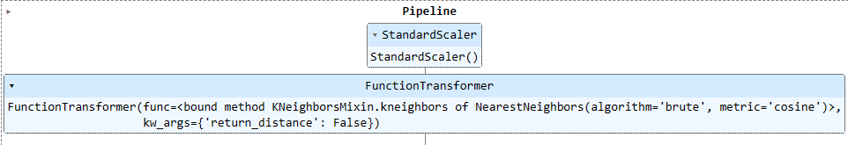
Design (Django Backend)
Dataset summary:
350,000+ food recipes take from Kaggle Food.com dataset
Include Nutrition Information
RecipeInstructions
Recommendation pipeline:
Utilize python scikit-learn, pandas, numpy libraries
Preprocessed with simple scaler
Find k-nearest neighbors meal recipes from the user’s nutrition_count()
Randomized by user required nutrition range
Deeper dive into the dataset: https://colab.research.google.com/drive/1jd4WGpXubp2r0lcywIj-gWe2w5mVZFSL?usp=sharing

Slide 13
Results
A navigable website formatted and styled
Functional meal recommender
Needs a bit more integration with account database
Functional account creator and manager
Account database needs a bit more depth

Slide 14
Challenges
Recommender runtime
Opt for k-nearest-neighbors for fast runtime and good performance
Lack experience in integrating between frontend and backend
Learn to separate functions into smaller components to complete
Authentication-based testing
Create manager, admin and dummy users to test different accounts
Have the backend send custom request to the front end
Implement a logical flow and applying suitable error handling

